Slide 1

Layout Templates
Please use these templates to create two versions of your celebration- “Plan A” refers to your ideal weather conditions; “Plan B” is in case of rain. We will use these layouts for setup.
A template for each major activity area is included. Please delete the slide if you’re not using that area.
Sample layouts are included in each template. Please move or delete objects to fit your design, number of guests, etc. Below, we’ve listed descriptions of each object (Please add objects obtained through outside vendors).
Objects
8
8-foot Standard Tables (16 available)
Wicker Chairs & Couch*
W
W
6
6-foot Standard Table (1 available)
W
W
Wicker Set Tables*
4
4-foot Standard Table (1 available)
100”
H
Propane Heaters* (4 avail.)
100-inch Reclaimed Wood Tables* (13 avail.)
50”
4-foot Reclaimed Wood Tables* (2 available)
Bar
Reclaimed Wood Bar*
C
30” Cocktail Tables* (4 available)
B
36” Bistro Tables* (4 available)
*Optional amenities may be rented.

Slide 2
Plan A
(No rain)

Slide 3
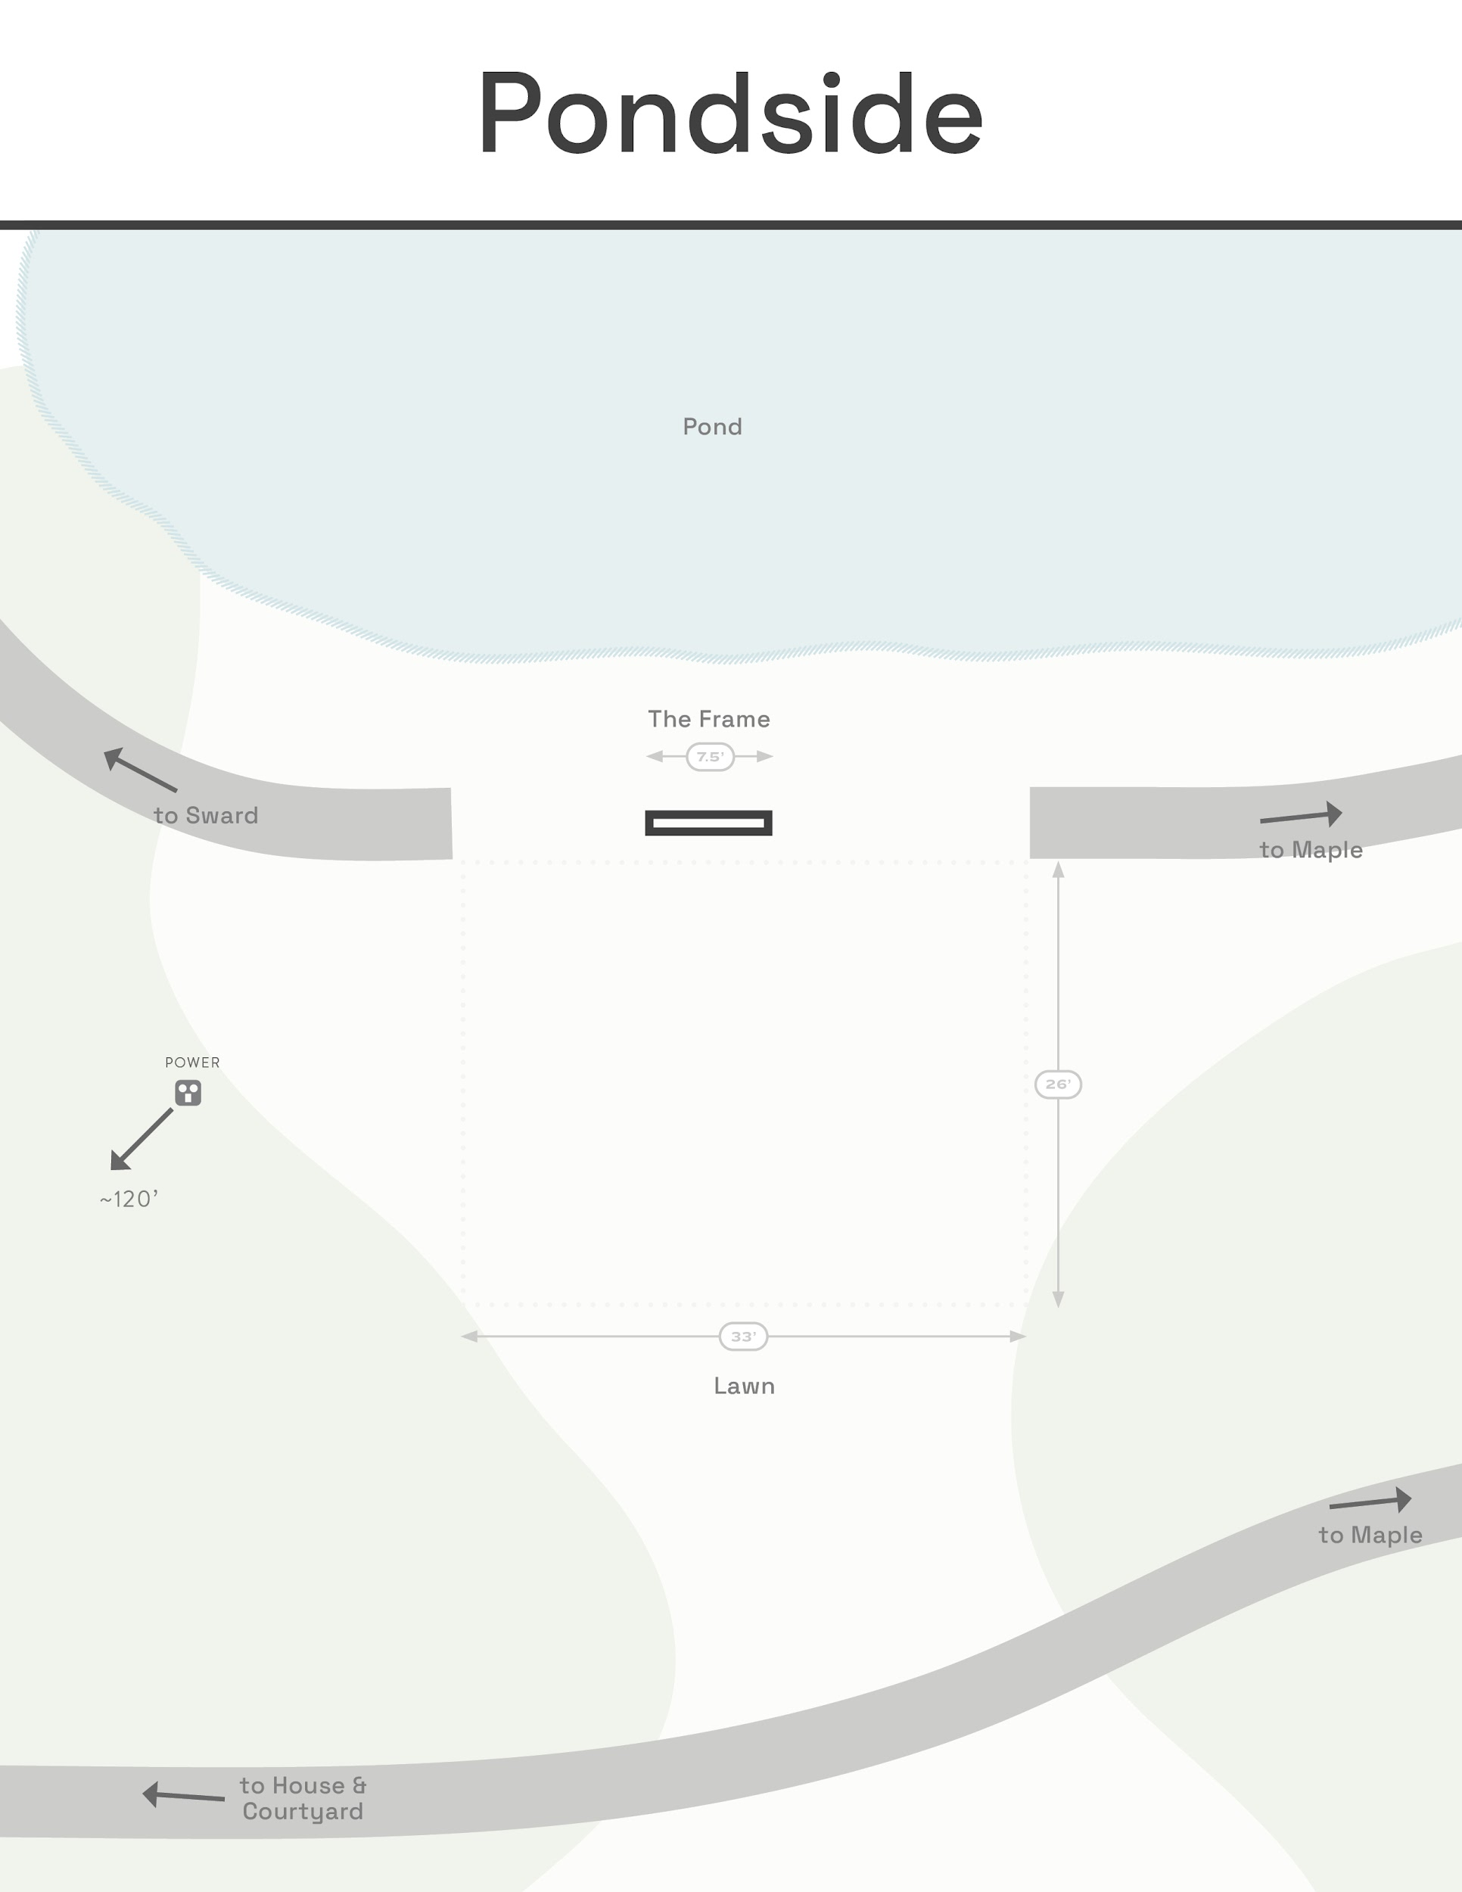
100 guests total;
97 seated on lawn w/ aisle.
3 standing (couple + officiant)

Slide 4
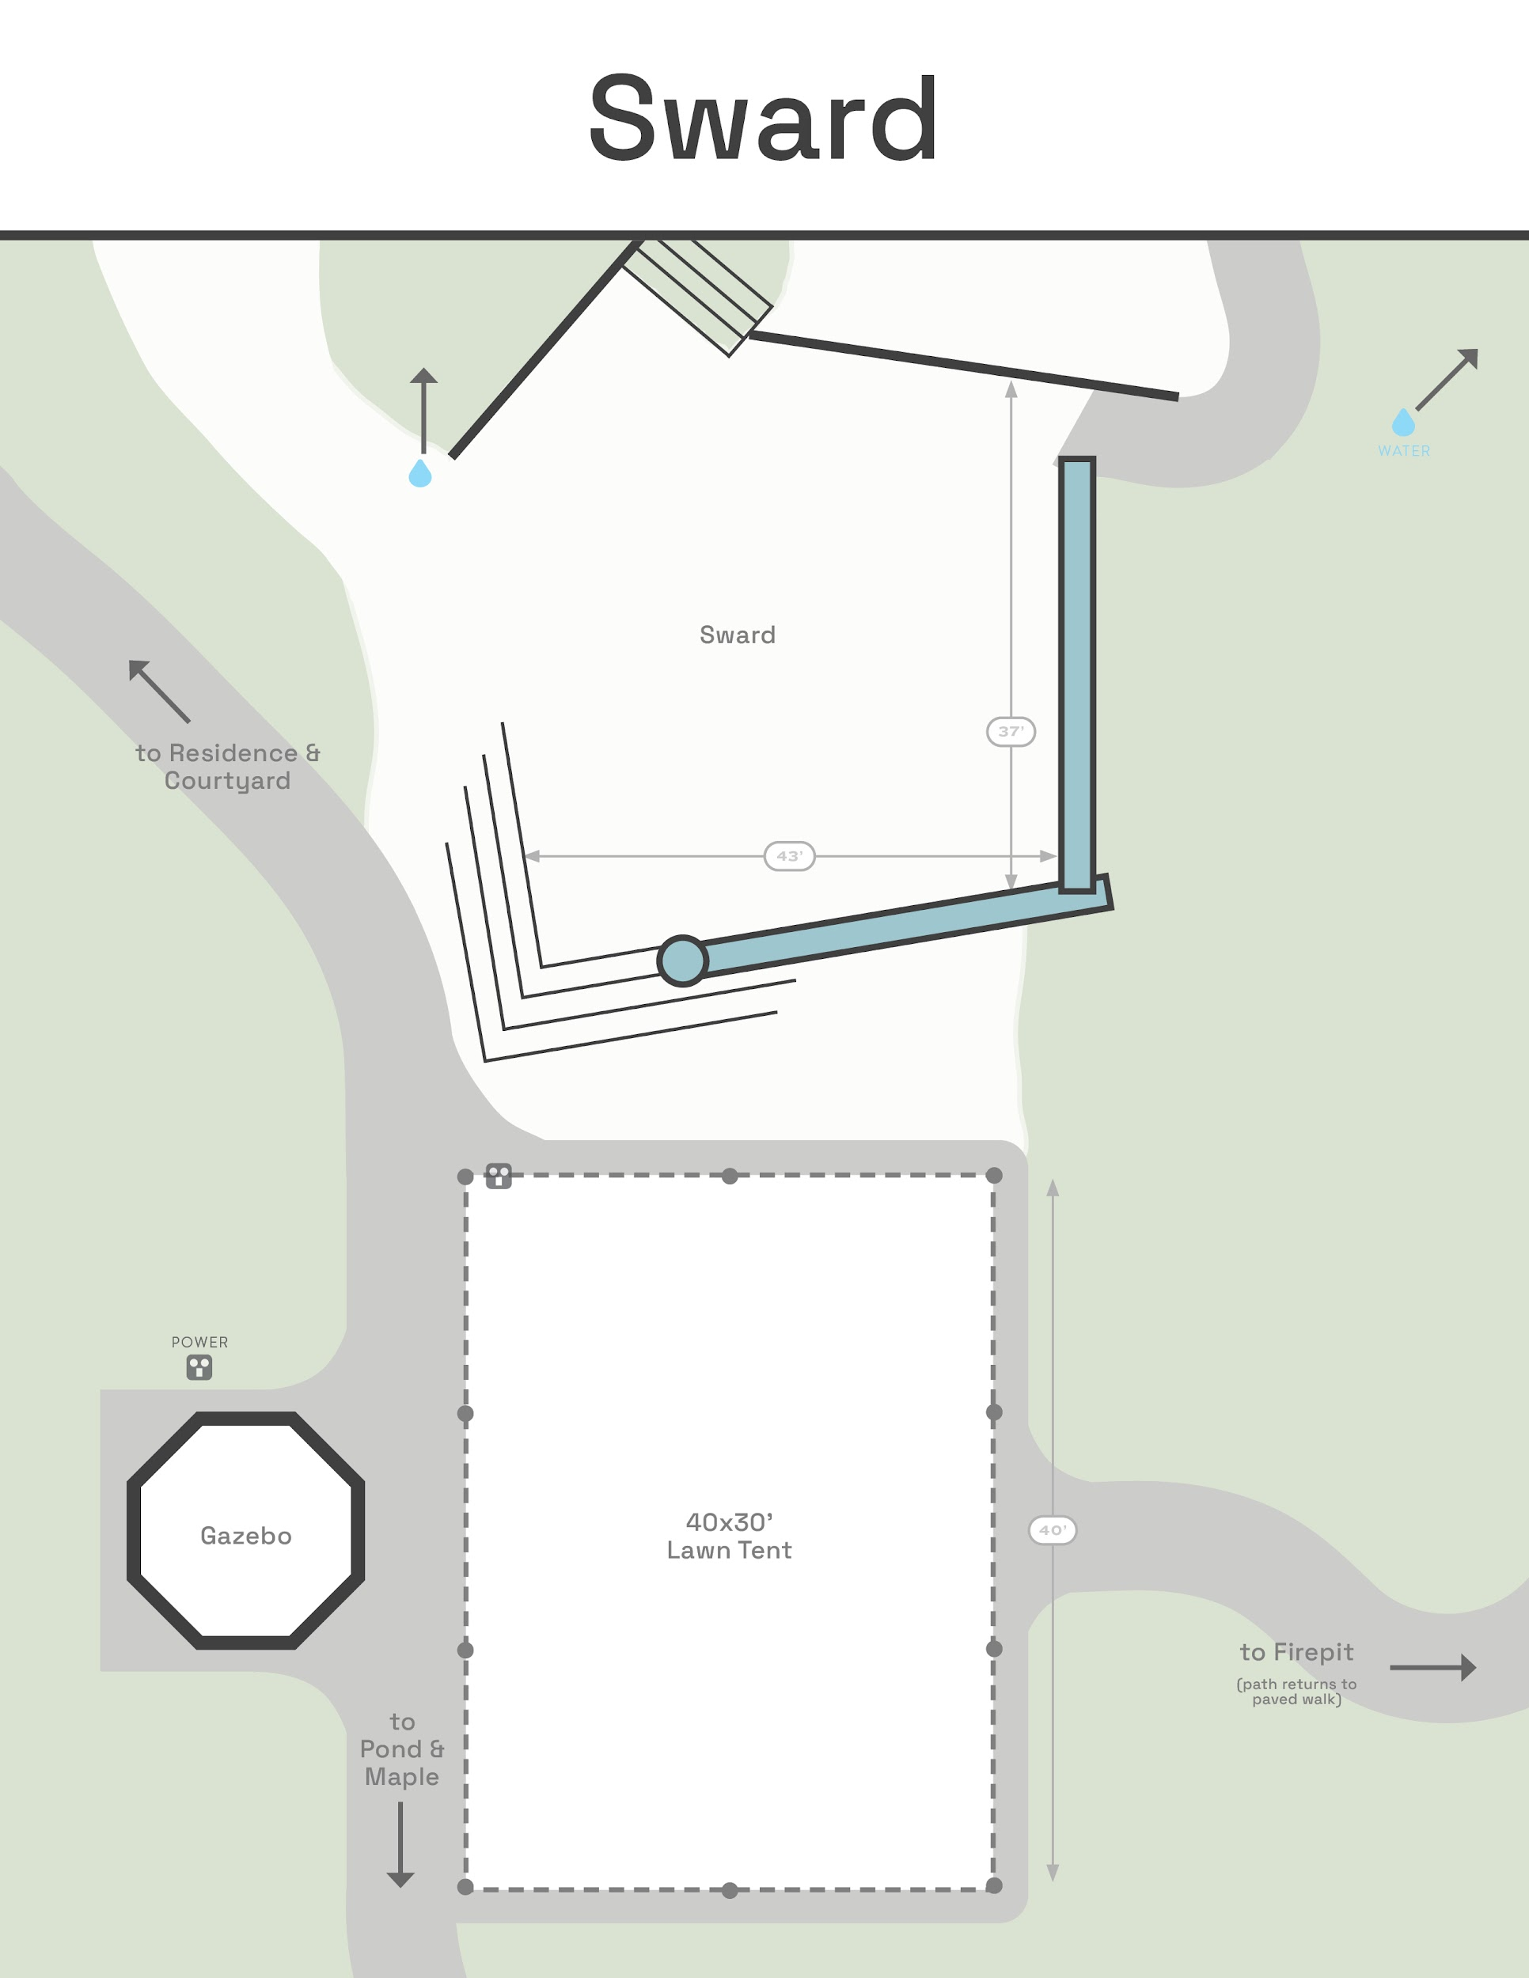
99 guests total;
96 seated on lawn w/ aisle.
3 standing (couple + officiant)

Slide 5
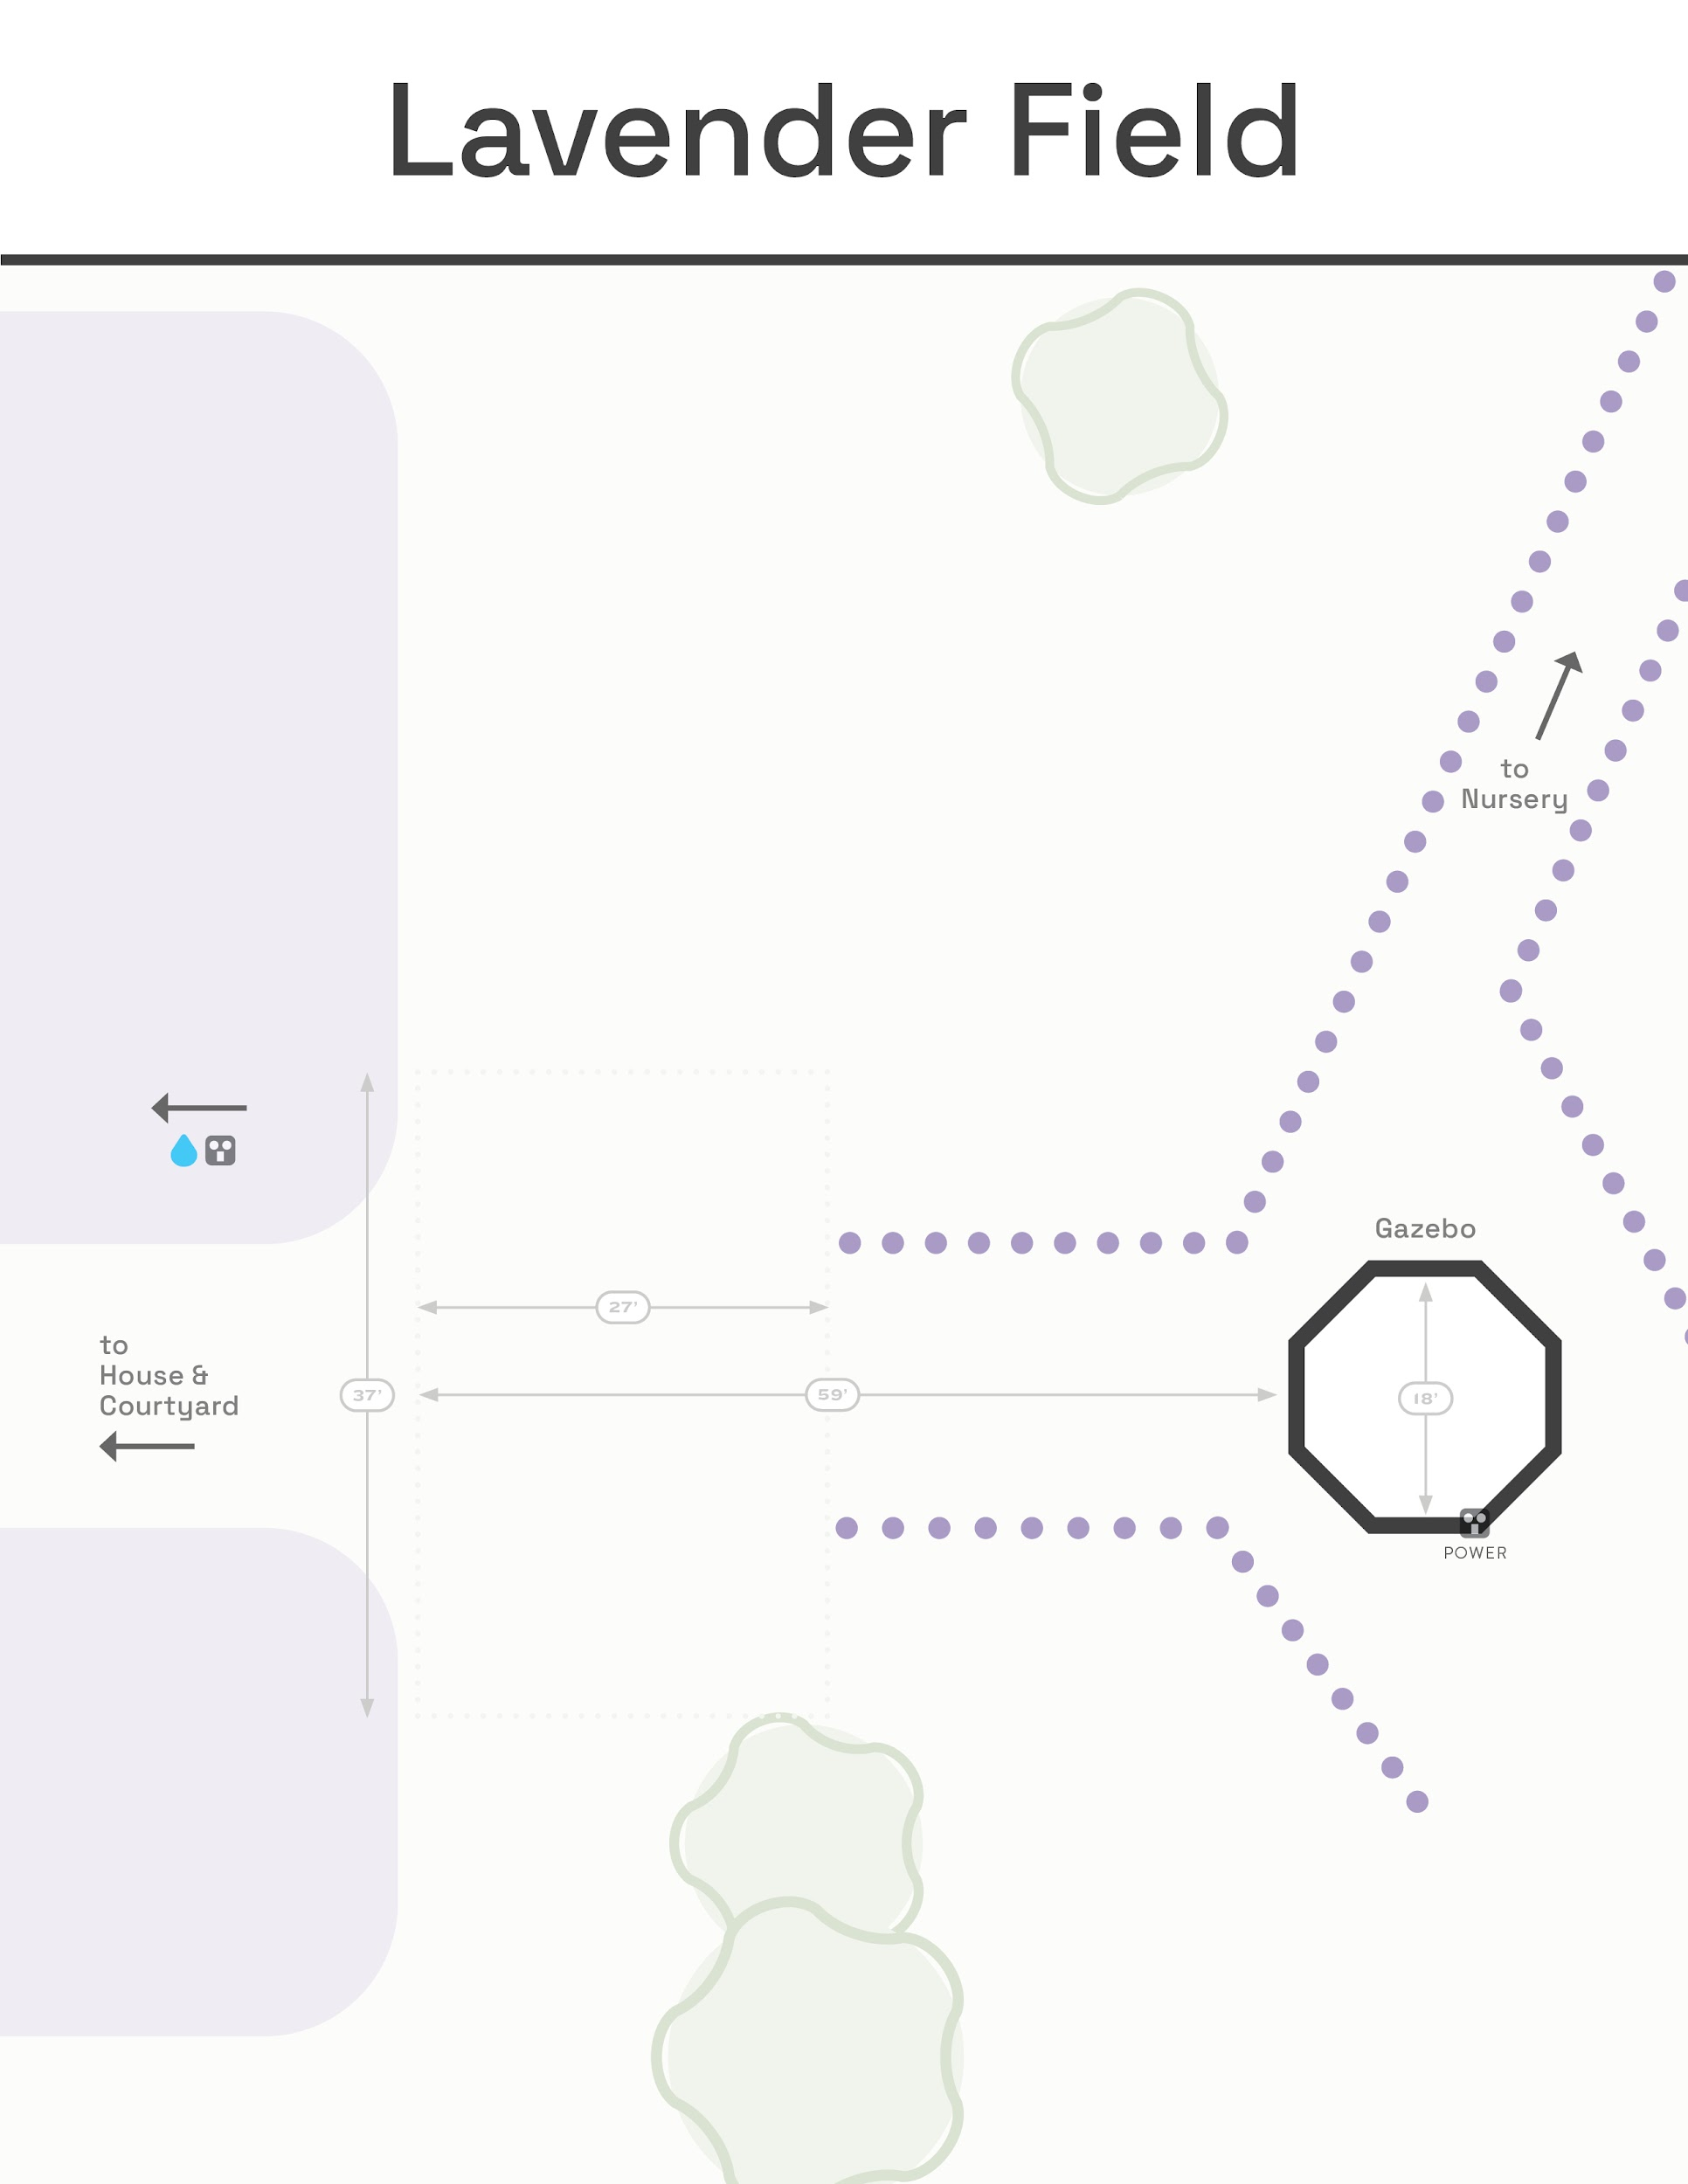
100 guests total;
97 seated on lawn w/ aisle.
3 standing (couple + officiant)

Slide 6
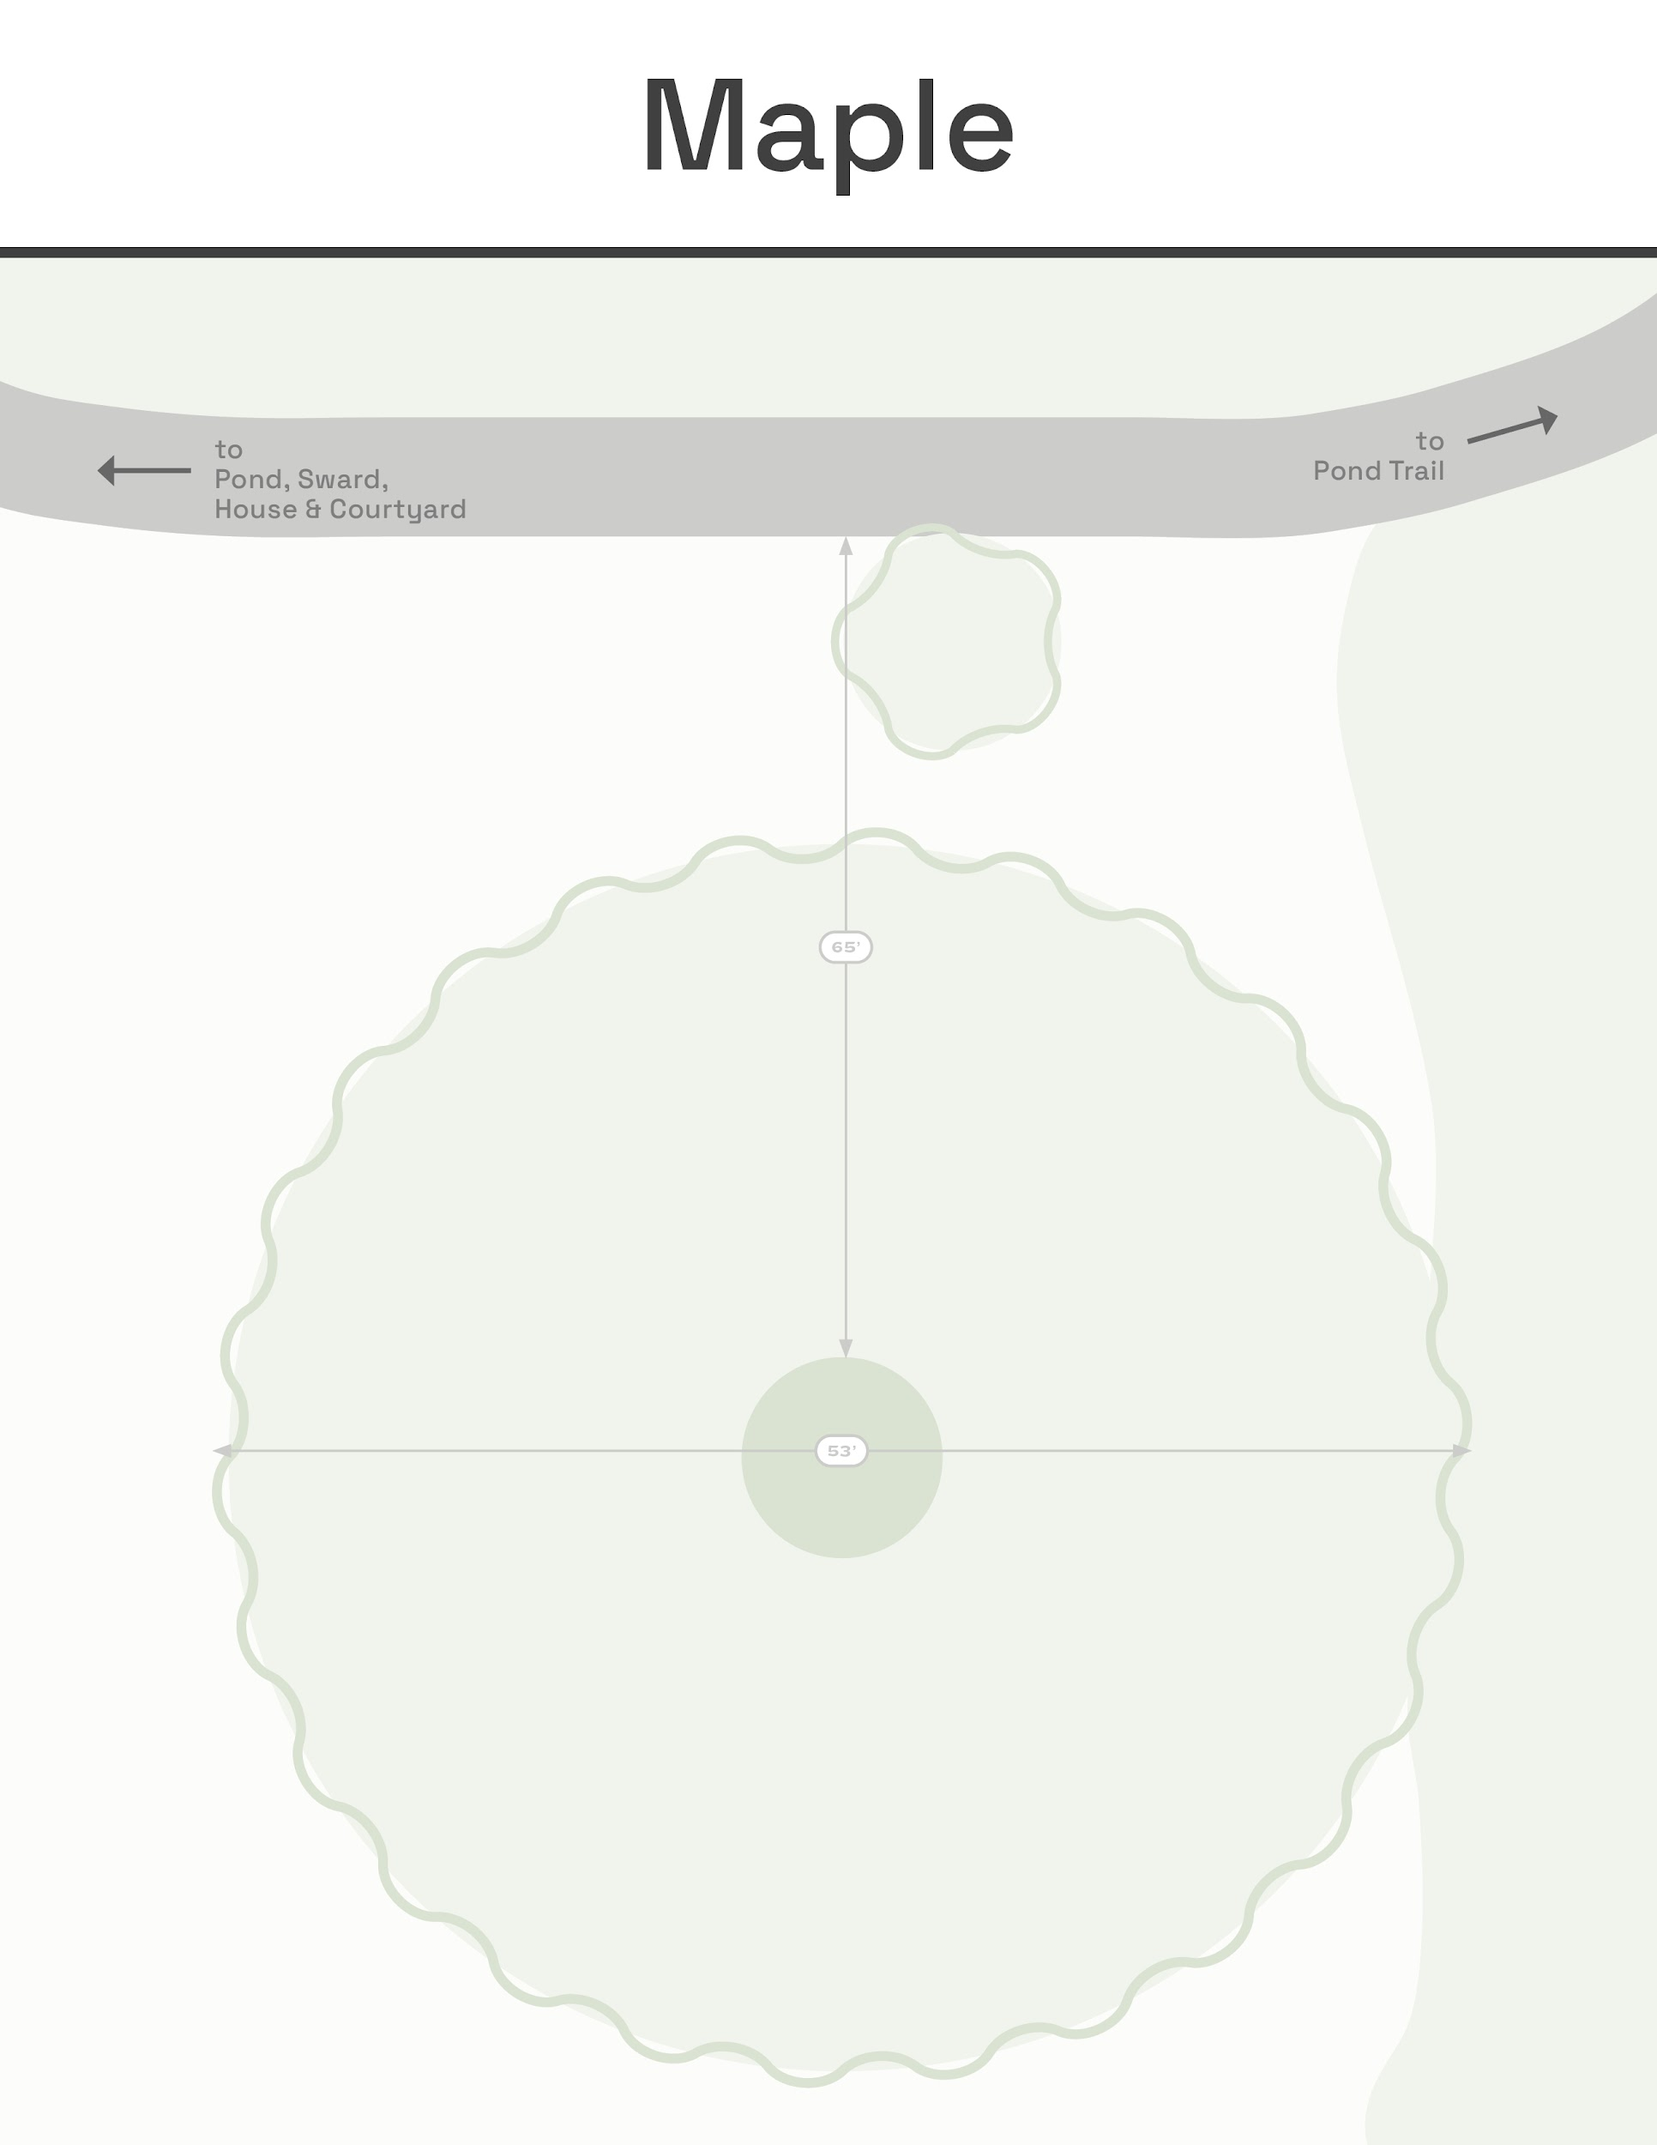
100 guests total;
97 seated on lawn w/ aisle.
3 standing (couple + officiant)

Slide 7
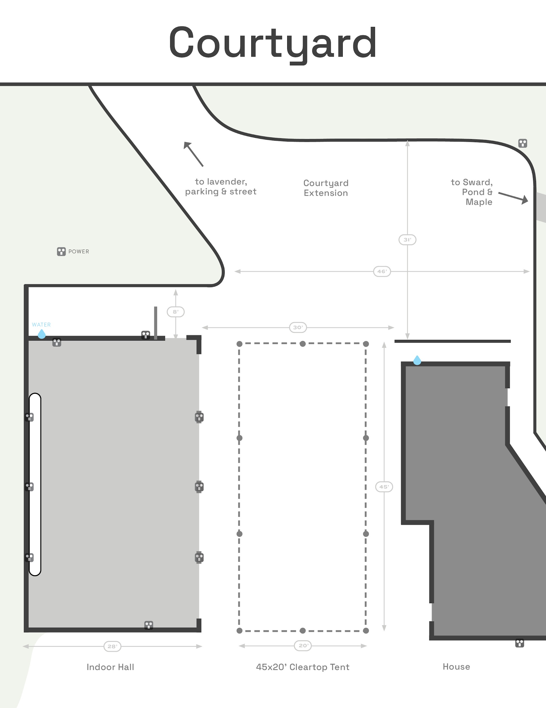
C
C
W
W
W
W
W
C
W
W
H
H
H
C
W
Bar
6
8
8
8
B
8
8
8
100”
B
100”
8
8
8
B
8
8
8
B
4

Slide 8
Plan B
(Rain)

Slide 9
100 guests total;
97 seated on lawn w/ aisle.
3 standing (couple + officiant)

Slide 10
99 guests total;
96 seated on lawn w/ aisle.
3 standing (couple + officiant)

Slide 11
100 guests total;
97 seated on lawn w/ aisle.
3 standing (couple + officiant)

Slide 12
100 guests total;
97 seated on lawn w/ aisle.
3 standing (couple + officiant)

Slide 13
C
C
W
W
W
W
W
C
W
W
H
H
H
C
W
Bar
6
8
8
8
B
8
8
8
100”
B
100”
8
8
8
B
8
8
8
B
4

